Slide 1


SAP Full-Stack Developer training
ABAP on HANA, UI5 & Fiori, Analytics with OData
Anubhav Oberoy
Day – 15

Slide 2

Agenda – Day 15
Understanding CDS Security
CDS Table Functions
CDS-BOPF Integration
Describing Validation in ( Business Object ) BO
Implementation of Smart filter UX Application
Transactional UX App with CDS and BOPF
--Break--
Hierarchy CDS Programming with Tree Table
New Hierarchy
Classical Hierarchy
Implementation of End to End Hierarchy Scenario of Employee Manager Hierarchy
Describing Functional Information of Hierarchy

Slide 3
CDS Data Control Language ( DCL )
Declarative approach instead of coded
Based on CDS modeling objects and therefore part of the data-model
Authorizations are also pushed down to DB by extending the Open SQL SELECT statement
Authorizations are only defined once and automatically (re-) used everywhere
Classical approach
DCL approach
PFCG
<Code>
PFCG
<Code>
DCL
SQL
&
SQL
ABAP Authorization Check
CDS View
<Code>
<Code>

Slide 4





Authorizations for CDS Views
All CDS views which expose sensitive or data privacy and protection relevant data must be secured.
Access restrictions on record level are expressed by roles in the Data Control Language (DCL).
Authorization enforcements of DCLs are automatically applied for direct ABAP SQL selects on their protected CDS views.
Authorization enforcements of DCLs are injected as additional filter criteria.
If multiple DCLs are defined for a single CDS view the access restrictions are combined by a logical OR (i.e. the access is less restricted than defined by the individual DCLs).

Slide 5

Aspect
An aspect can be used to define user-dependent values which can be compared to one or more columns of the data model
PFCG_AUTH aspect is a pre-delivered aspect that links the object model not to a user attribute but to his ABAP PFCG authorizations
USER aspect can be used to compare the current logged on user with column of the date model

Slide 6
Runtime Behavior
During runtime the SELECT statement for a CDS view will automatically be enhanced with the authorization filter.
SELECT … FROM … INTO …
WHERE … AND <Authorization Filter Condition>
Authorization check
ABAP Database Base
Authorization Object
View fields
DCL
DDL CDS view
User Profile
Notes:
The sole purpose of an R/3 system is to provide a suite of tightly integrated, large-scale business applications. R/3 comes prepackaged with the core business applications needed by most large corporations. These applications coexist in one homogenous environment. They are designed from the ground up to run using a single database and one (very large) set of tables.
Presentation: It is usually installed on a user's workstation. When started, the presentation server displays the R/3 menus within a window. This window is commonly known as the SAPGUI, or the user interface (or simply, the interface).
Basis : Basis is like an operating system for R/3. It sits between the ABAP/4 code and the computer's operating system. SAP likes to call it middleware because it sits in the middle, between ABAP/4 and the operating system. ABAP/4 cannot run directly on an operating system. It requires a set of programs (collectively called Basis) to load, interpret, and buffer its input and output. Basis provides the runtime environment for ABAP/4 programs.
Database: The database server is a set of executables that accept database requests from the application server. These requests are passed on to the RDBMS (Relation Database Management System). The RDBMS sends the data back to the database server, which then passes the information back to the application server. The application server in turn passes that information to your ABAP/4 program.

Slide 7
Which DCL Roles are Evaluated When ?
CDS Views
DCL Roles
ABAP Open SQL
SELECT AttributeB,
AttributeA
FROM VIEW_D
VIEW_D
ROLE_D
AttributeB
_VIEW_A.AttributeA
grant select on
VIEW_D …
Effective: ROLE_D
<<select from>>
SELECT AttributeB,
_VIEW_A.AttributeA
FROM VIEW_C
VIEW_C
ROLE_C
Effective: ROLE_A resp. ROLE_C
AttributeB
Association: _VIEW_A
grant select on
VIEW_C …
<<select from>>
VIEW_B
ROLE_B
SELECT AttributeB
FROM VIEW_B
AttributeB
grant select on
VIEW_B …
Effective: ROLE_B
<<association>>
VIEW_A
ROLE_A
AttributeA
grant select on
VIEW_A …

Slide 8

Exercise
CDS Security with DCL.
Notes:
The sole purpose of an R/3 system is to provide a suite of tightly integrated, large-scale business applications. R/3 comes prepackaged with the core business applications needed by most large corporations. These applications coexist in one homogenous environment. They are designed from the ground up to run using a single database and one (very large) set of tables.
Presentation: It is usually installed on a user's workstation. When started, the presentation server displays the R/3 menus within a window. This window is commonly known as the SAPGUI, or the user interface (or simply, the interface).
Basis : Basis is like an operating system for R/3. It sits between the ABAP/4 code and the computer's operating system. SAP likes to call it middleware because it sits in the middle, between ABAP/4 and the operating system. ABAP/4 cannot run directly on an operating system. It requires a set of programs (collectively called Basis) to load, interpret, and buffer its input and output. Basis provides the runtime environment for ABAP/4 programs.
Database: The database server is a set of executables that accept database requests from the application server. These requests are passed on to the RDBMS (Relation Database Management System). The RDBMS sends the data back to the database server, which then passes the information back to the application server. The application server in turn passes that information to your ABAP/4 program.

Slide 9
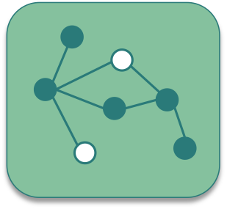
CDS Table Function
CDS Table Functions allow to use natively implemented database-functions in SAP HANA DB directly from CDS

Slide 10

Why we need CDS Table Function
CDS is an open extension of classical DDIC views:
Support for AnyDB
Optimal integration into DDIC and ABAP
Supports about 90 % of SQL features
But: no access to specific HANA features
Required: Some scenarios require selective measure (“Breakout Scenario” for HANA-only applications)
Highest performance requirements e.g. with complex calculations
Use of database / analytical engine specific functions required
Open SQL and CDS views do not yet offer functionality to solve the problem

Slide 11
Necessary part of CDS Table Function
Table function definition
Parameter list
Return Parameter
Reference to implementing method
Runtime for table function
Runs stored SQL-script procedure generated from AMDP on database tables
ABAP Managed Database Procedure
SAP HANA Database
DDL Source
AMDP Implementation
Includes SQL-script function body
Notes:
The sole purpose of an R/3 system is to provide a suite of tightly integrated, large-scale business applications. R/3 comes prepackaged with the core business applications needed by most large corporations. These applications coexist in one homogenous environment. They are designed from the ground up to run using a single database and one (very large) set of tables.
Presentation: It is usually installed on a user's workstation. When started, the presentation server displays the R/3 menus within a window. This window is commonly known as the SAPGUI, or the user interface (or simply, the interface).
Basis : Basis is like an operating system for R/3. It sits between the ABAP/4 code and the computer's operating system. SAP likes to call it middleware because it sits in the middle, between ABAP/4 and the operating system. ABAP/4 cannot run directly on an operating system. It requires a set of programs (collectively called Basis) to load, interpret, and buffer its input and output. Basis provides the runtime environment for ABAP/4 programs.
Database: The database server is a set of executables that accept database requests from the application server. These requests are passed on to the RDBMS (Relation Database Management System). The RDBMS sends the data back to the database server, which then passes the information back to the application server. The application server in turn passes that information to your ABAP/4 program.

Slide 12
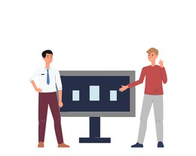
Key Feature of Table Function
They are implemented in HANA SQLScript via AMDP methods
Signature is defined in DDL source (importing parameters and return columns)
They can be consumed by Open SQL and ABAP CDS like other DDIC artifacts (i.e. DB tables, classical DDIC views, CDS views ...)
The SQLScript implementation is handled by the AMDP framework (lifecycle, tool support, extensibility etc.)
DDL source can be activated before the implementing AMDP method exists.

Slide 13

Exercise
CDS Table Function Code

Slide 14

CDS BOPF
The Business Object Processing Framework is an ABAP OO-based framework that provides a set of generic services and functionalities to speed up, standardize, and modularize your development. BOPF manages the entire life cycle of your business objects and covers all aspects of your business application development.

Slide 15
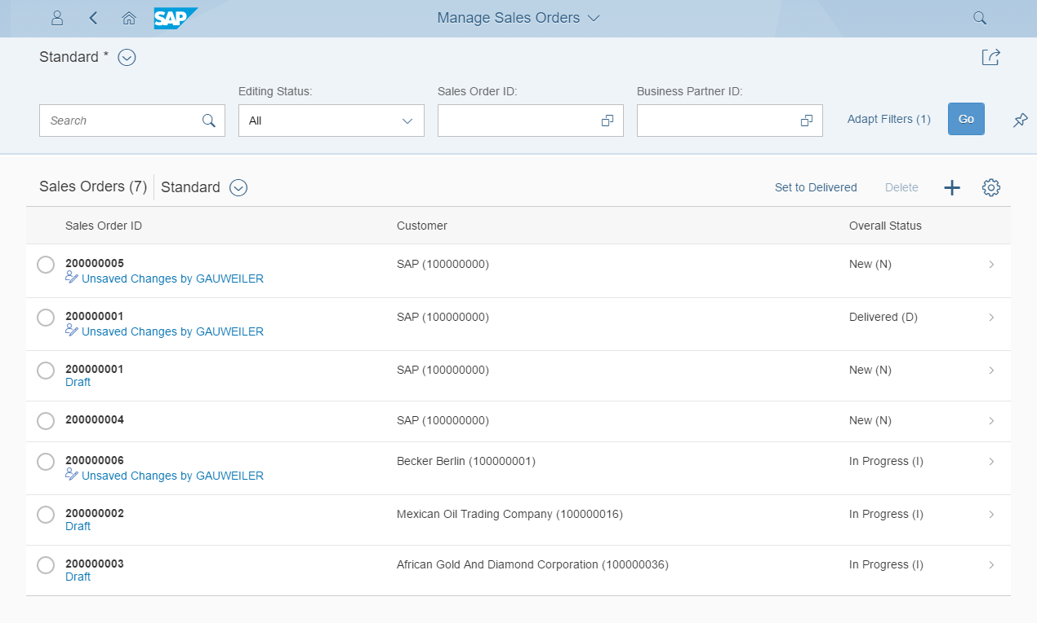
Development flow & Artifacts
consume
SAP Fiori Elements, …
OData Service
Consumption view
Consumption view
Search Object(s)
Core Data Services
generate / publish
Subnode consumption view
Subnode consumption view
Subnode consumption view
Subnode consumption view
Metadata Extension
enrich
Data Definition
generate
BOPF Business Object
implement
Custom ABAP Business Logic
Draft table
Draft table
Database table
Draft table

Slide 16
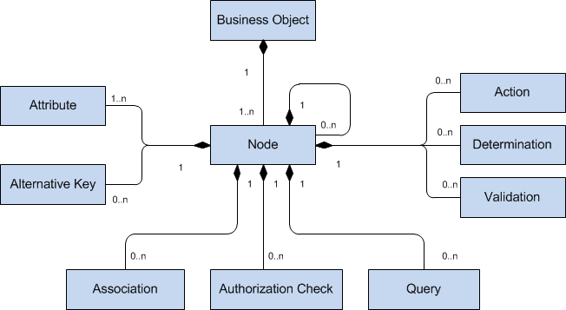
Business Object
The business objects are the basic units of the BOPF-based programming model. Business applications or processes operate on certain business objects. A business object is represented as a hierarchical tree of nodes. A single node includes a set of semantically related business object data and the corresponding business logic. On the technical level, each node is implemented with a regular Dictionary table, where each node instance corresponds to a single table entry (table rows). Nodes, attributes, and alternative keys set up the data part of a business object. Again from a technical viewpoint, attributes form the columns of the table. A node serves as an anchor point for connecting the business logic of the business object.

Slide 17
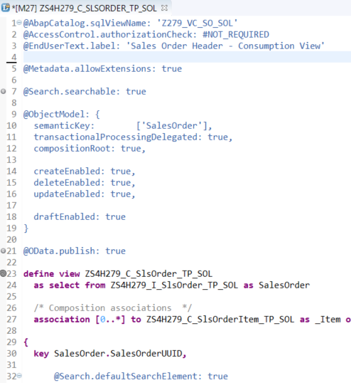
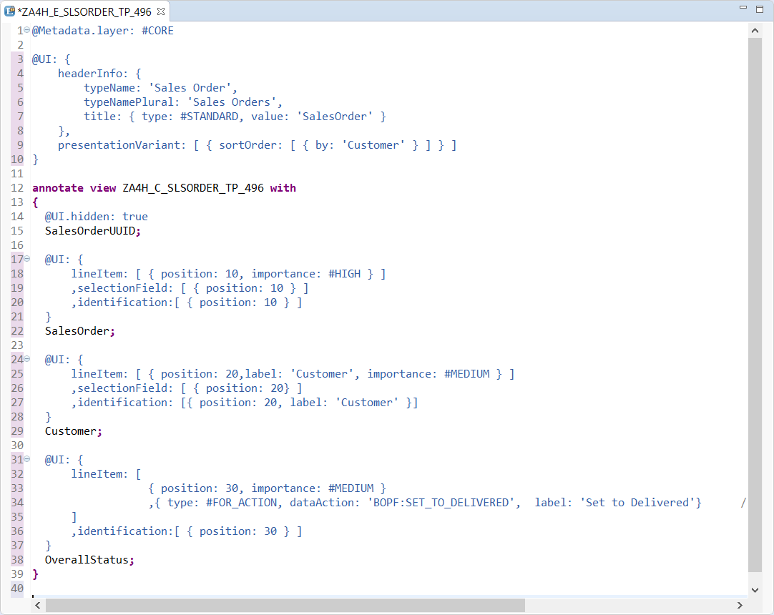
Transactional UX App with CDS & BOPF
With Draft Functionality
Access Control
UI semantic
Search enablement
Transactional enablement
OData exposure

Slide 18

Exercise
CDS BOPF Scenario

Slide 19

Break

Slide 20
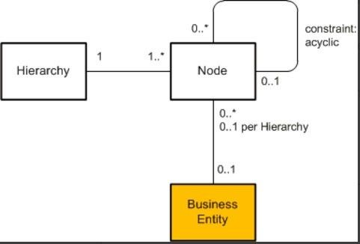
CDS Hierarchy
The CDS view provides a list of hierarchies which is known the hierarchy directory for this node view. Every single node belongs to exactly one hierarchy, which can identified by one or multiple key fields of the node view.
A hierarchy can have multiple root nodes.
Hierarchies allows to traverse data faster
They clearly explain the inter-relation between multiple object
Very helpful determining the parent child relationship

Slide 21
Types of Hierarchy
There are Two types of Hierarchy
Creating Using Annotations
Creating by syntax
CDS Hierarchy
New Hierarchy
Classical Hierarchy

Slide 22

End to End Hierarchy Scenario

Slide 23
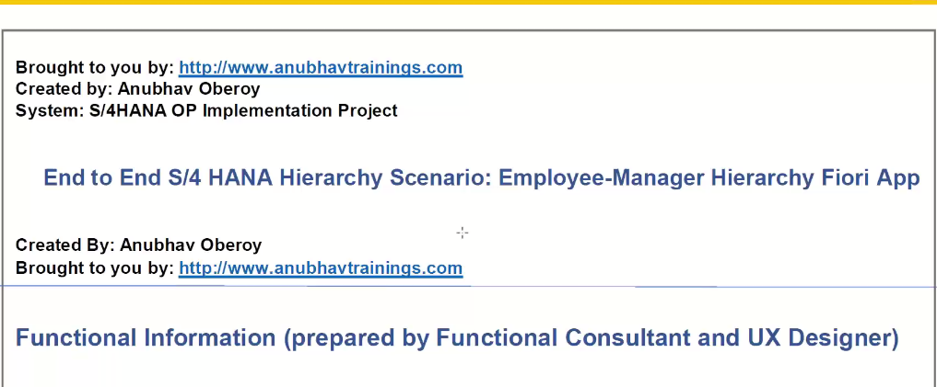
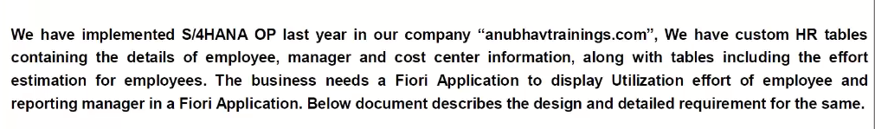
Elaborating Scenario

Slide 24
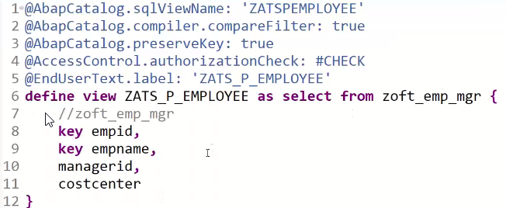
Creating Resource CDS

Slide 25
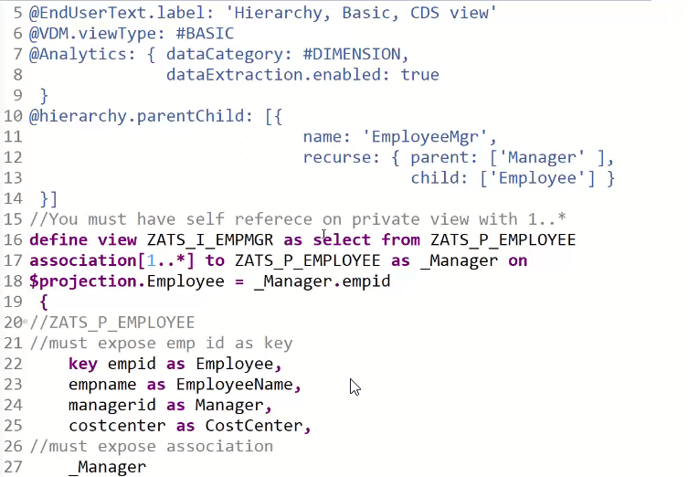
Creating Basic CDS View

Slide 26
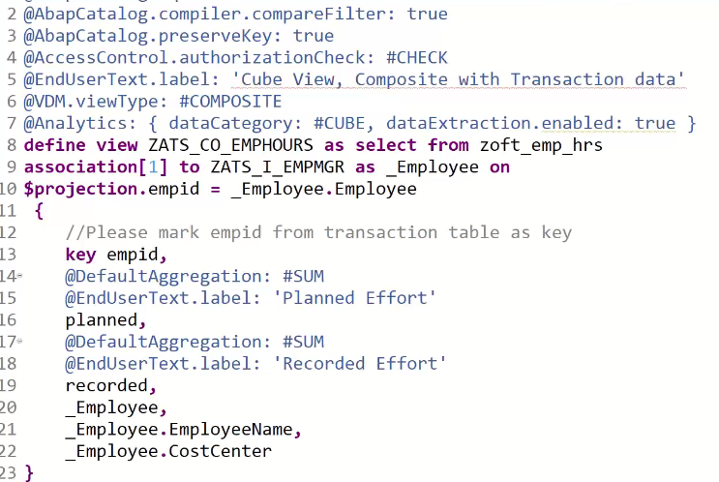
Composite CDS View

Slide 27
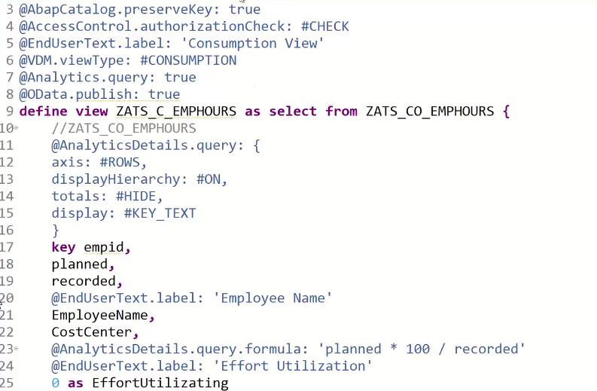
Consumption CDS View

Slide 28
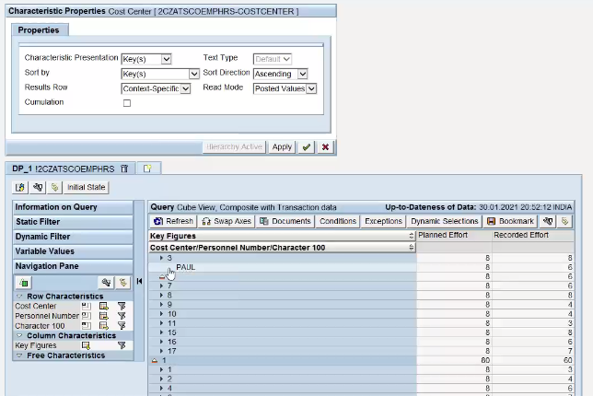
Check Hierarchy

Slide 29
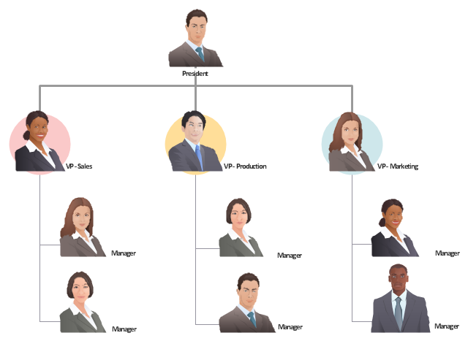
Exercise
CDS Hierarchy Scenario

Slide 30

End of Day 15

Slide 31

Questions

Slide 32

Anubhav Oberoy

Slide 33


We’re committed to empower you to be
Most Desirable Resource
through powerful training solutions.
We build the workforce of the future.
250+
Corporate Clients
30,000+
Learners Trained
25000+
Learners Placed
FREE WEBINARS
Sign up for free webinars with industry experts every fortnight!
Enroll Now!
Contact us today!
https://anubhavtrainings.com/

Slide 34




More from AnubhavTrainings.com

